Slide 1

Replication of TW Total Return Index
Yu-Ching Liao, Futures Prop. Trading Div., Prop. Trading Dept.

Slide 2
Problem Formulation

Slide 3
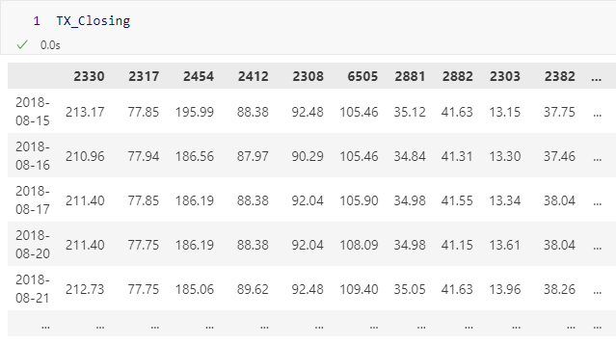
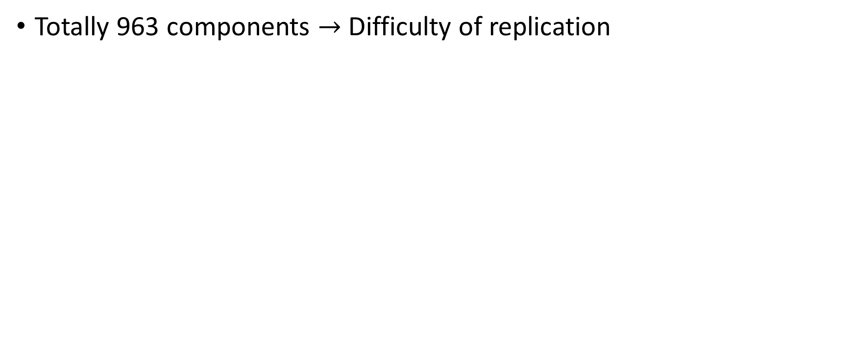
Problem Formulation:
Totally 963 components $→$ Difficulty of replication

Slide 4
Problem Formulation:
We are aiming to…
Replicate the index with lesser components.
Minimize the tracking error.

Slide 5

Problem Formulation:
Problem to be solved:
How much components?
How much training data?
How to achieve so?
$$N_{components}×N_{days}×Methodology$$

Slide 6
Dataset Overview

Slide 7
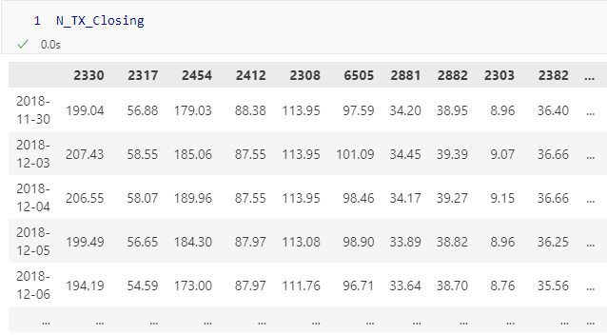
Adj. Close PX of Components
Time Interval: Daily
Ranged from 2018/11/30 to 2023/07/20

Slide 8
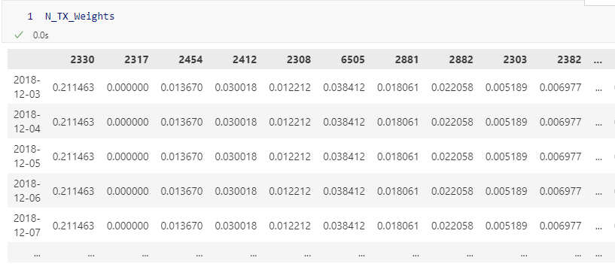
Weights of Components
Time Interval: Daily
Ranged from 2018/12/03 to 2023/07/20
P.S. This should be adjusted to sum-up to 100%.

Slide 9
Methods Review

Slide 10

Linear Regression
$${min\frac{1}{n}\sum{(\hat{y }−} y)}^{2}$$

Slide 11
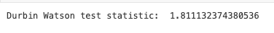
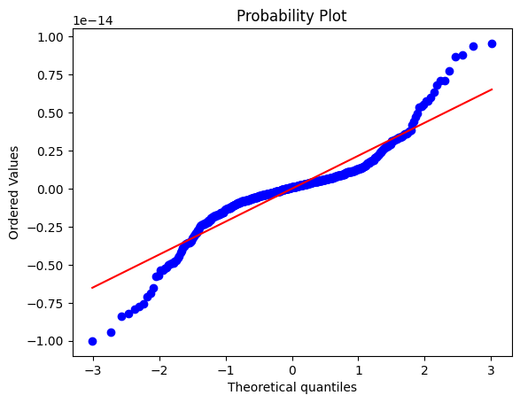
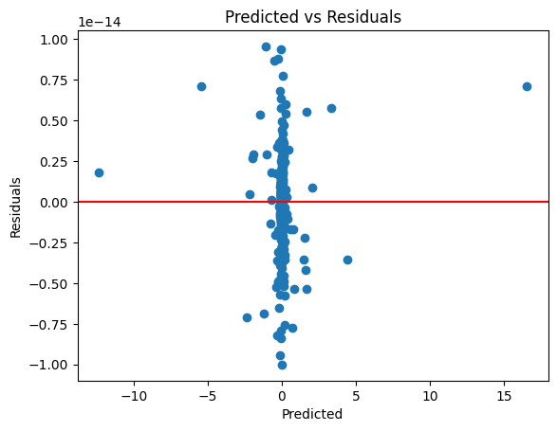
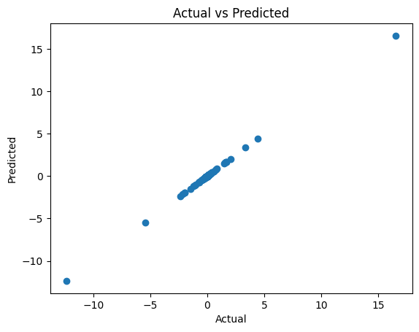
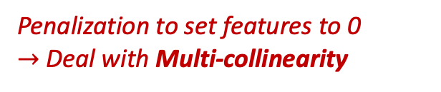
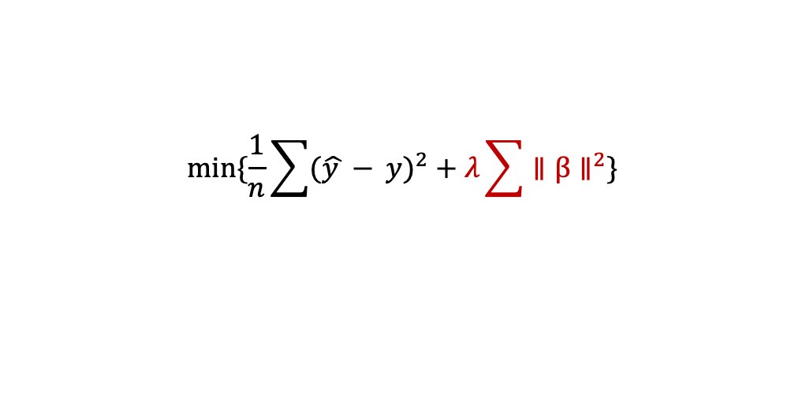
Lasso Regression
$${min⁡\{\frac{1}{n}\sum{(\hat{y }−} y)}^{2}+λ\sum{∥β∥^{2}}\}$$
Linear Regr. Assumption Check:
Penalization to set features to 0
$→$ Deal with Multi-collinearity
Independency: Passed
Homoscedasticity: Passed
Linearity: Passed
Normality in residual: Unpassed !!!!

Slide 12
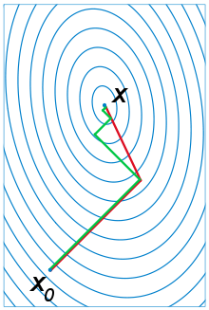
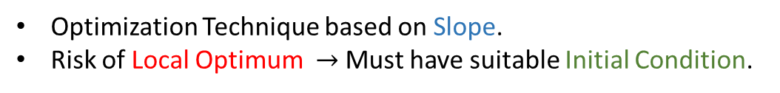
Conjugate Gradient Research
Optimization Technique based on Slope.
Risk of Local Optimum $→$ Must have suitable Initial Condition.

Slide 13
Data Handling – Dealing with NaNs

Slide 14
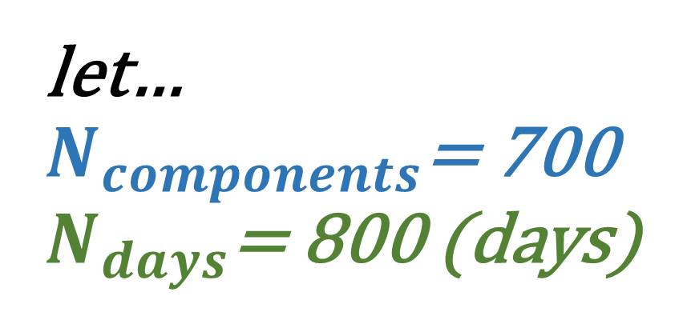
let… $N_{components}$= 700 $N_{days}$= 800 (days)

Slide 15
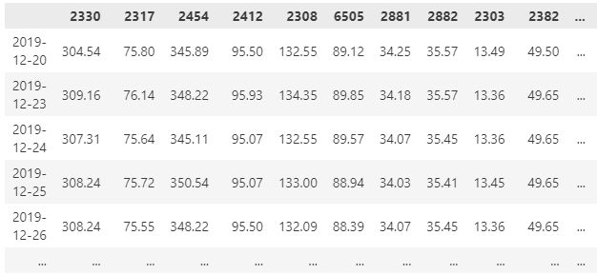
Step 1: Get Latest 700 x 800 daily data
P.S. Should have 800 rows after dealing with NaN values.

Slide 16
Tips: How to deal with NaNs?
We can get the data with no NaNs except unlisted stocks!!!

Slide 17

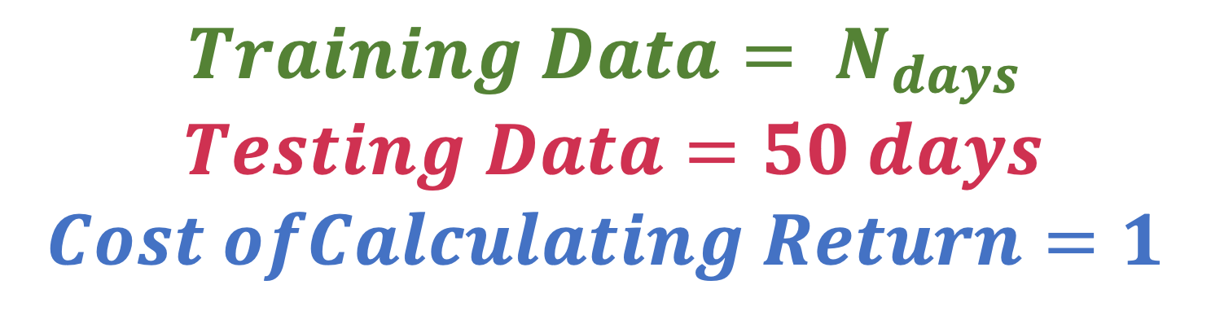
Tips: How much data we need? :
$$Training Data= N_{days}$$
$Testing Data=50 days$
$$Cost ofCalculating Return=1$$
$$=Totally N+50+1 Data$$

Slide 18
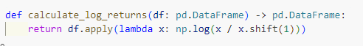
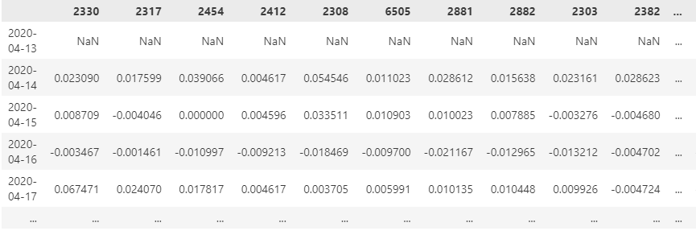
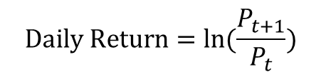
Step 2: Get Daily Return
$$Daily Return=ln⁡(\frac{P_{t+1}}{P_{t}})$$

Slide 19
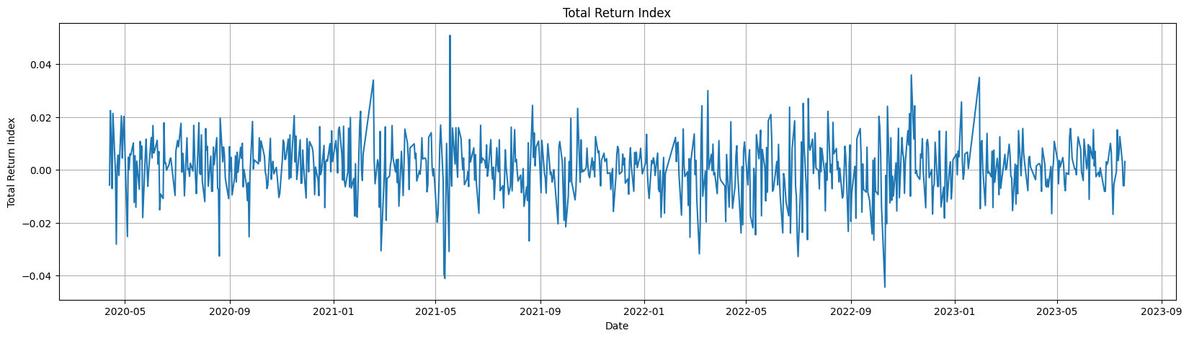
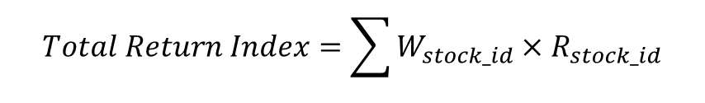
Step 3: Get Total Return Idx.
$$Total Return Index=\sum{W_{stock_id}×R_{stock_id}}$$

Slide 20
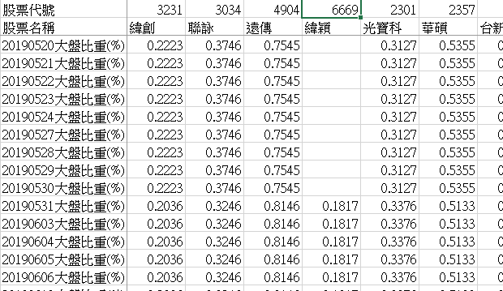
Step 4: Deal with Unlisted Components

Slide 21
Data Handling – Dealing with Unlisted

Slide 22






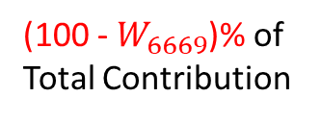
Step 1: Deal with Unlisted Components
$$※C=Contribution$$
$$R_{components}$$
$$C_{6669}$$
$$R_{components−6669}$$
$$TRX − C_{6669}$$
$$R_{6669}$$
$$TRX$$
Number of Features = 800
100% of Total Contribution
Number of Features = 799
(100 - $W_{6669}$)% of Total Contribution

Slide 23

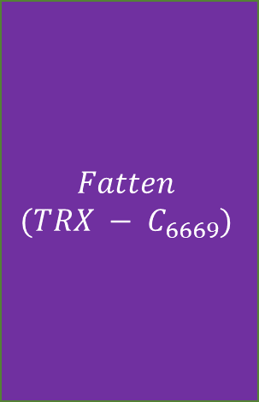

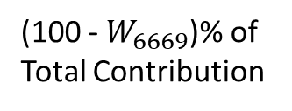

Step 1: Deal with Unlisted Components(cont.)
$$※C=Contribution$$
$$R_{components−6669}$$
$$TRX − C_{6669}$$
$$R_{components−6669}$$
$$Fatten$$
$$(TRX − C_{6669})$$
Number of Features = 799
(100 - $W_{6669}$)% of Total Contribution
Number of Features = 799
100% of Total Contribution

Slide 24

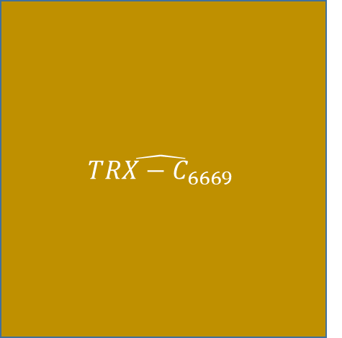
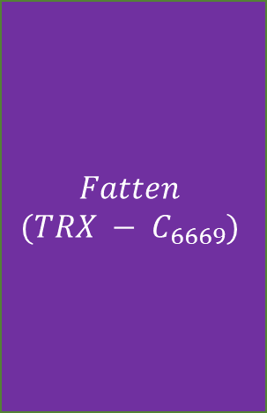
Step 2: Fit and Adjust
$$※C=Contribution$$
$$R_{components−6669}$$
$$Fatten$$
$$(TRX − C_{6669})$$
$$\hat{TRX−C_{6669}}$$
Fit
On
To Get
Number of Features = 799
100% of Total Contribution
100% of Total Contribution

Slide 25







Step 3: Comparison
$$\hat{TRX−C_{6669}}$$
$$R_{6669}$$
$$TRX$$
$${(1−W}_{6669})×$$
$$+W_{6669}×$$
VS
(100 - $W_{6669}$)% of Total Contribution
$W_{6669}$% of Total Contribution
100% of Total Contribution

Slide 26
Experiment

Slide 27

$$N_{components}×N_{days}×Methodology$$

Slide 28
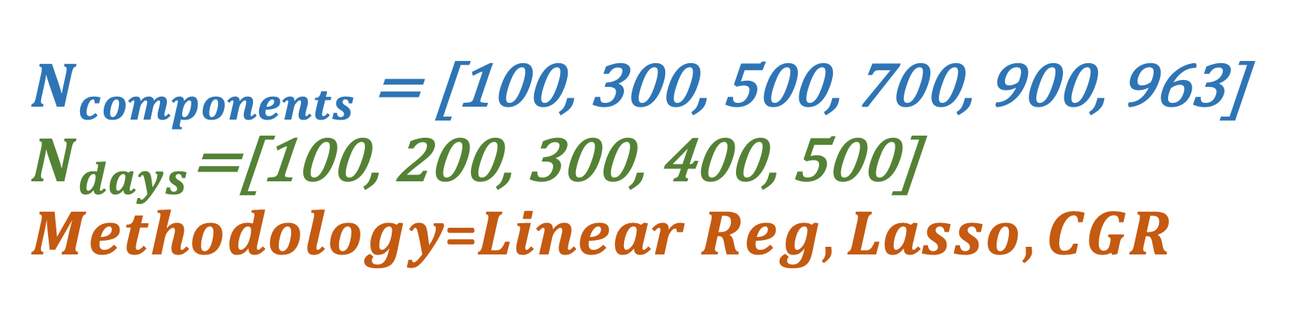
$N_{components}$ = [100, 300, 500, 700, 900, 963] $N_{days}$=[100, 200, 300, 400, 500] $Methodology$=$Linear Reg, Lasso, CGR$

Slide 29
Method 1: Linear Reg.

Slide 30
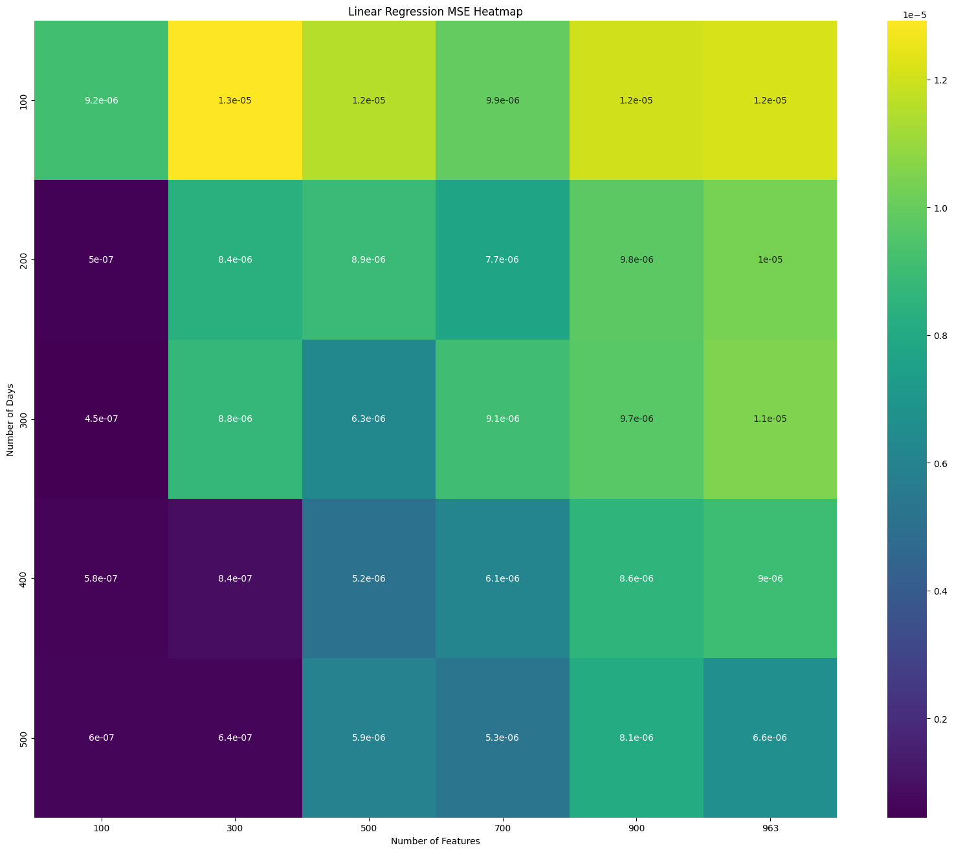
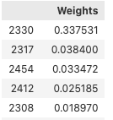
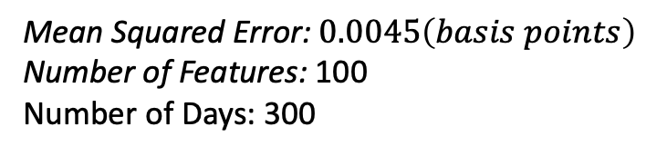
Numerical Results:
Mean Squared Error: $0.0045\left(basis points\right)$
Number of Features: 100
Number of Days: 300

Slide 31
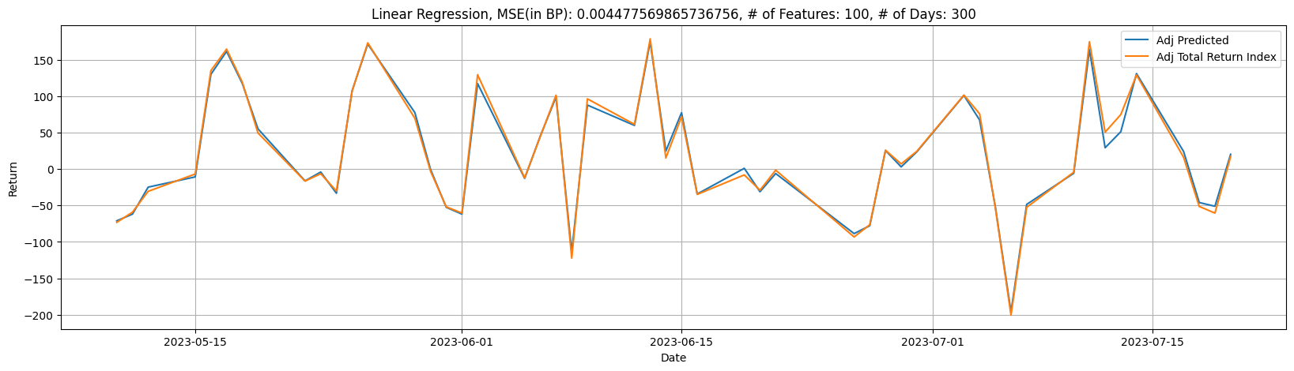
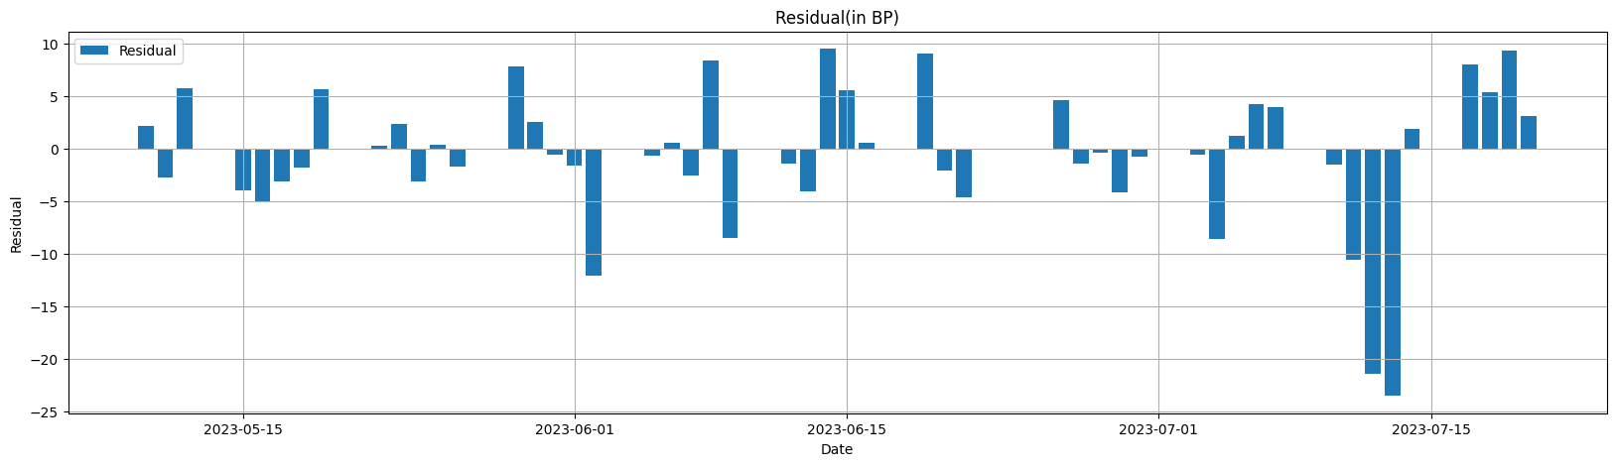
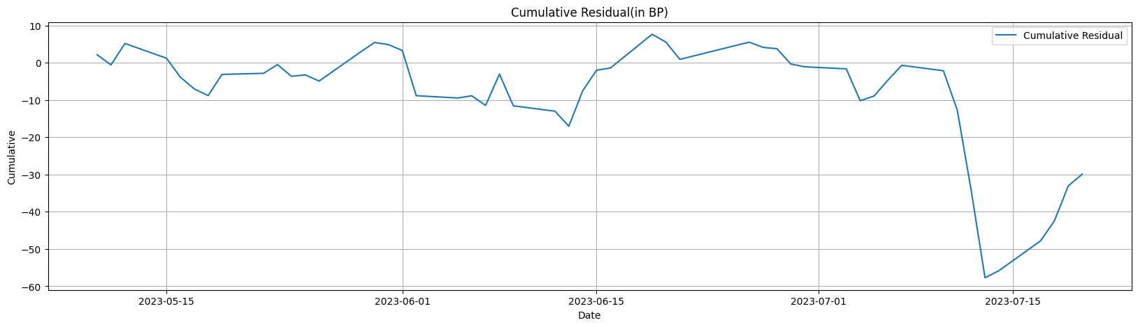
Numerical Results:
Residuals.
Cum. Residuals.

Slide 32
Method 2: Lasso Reg.

Slide 33
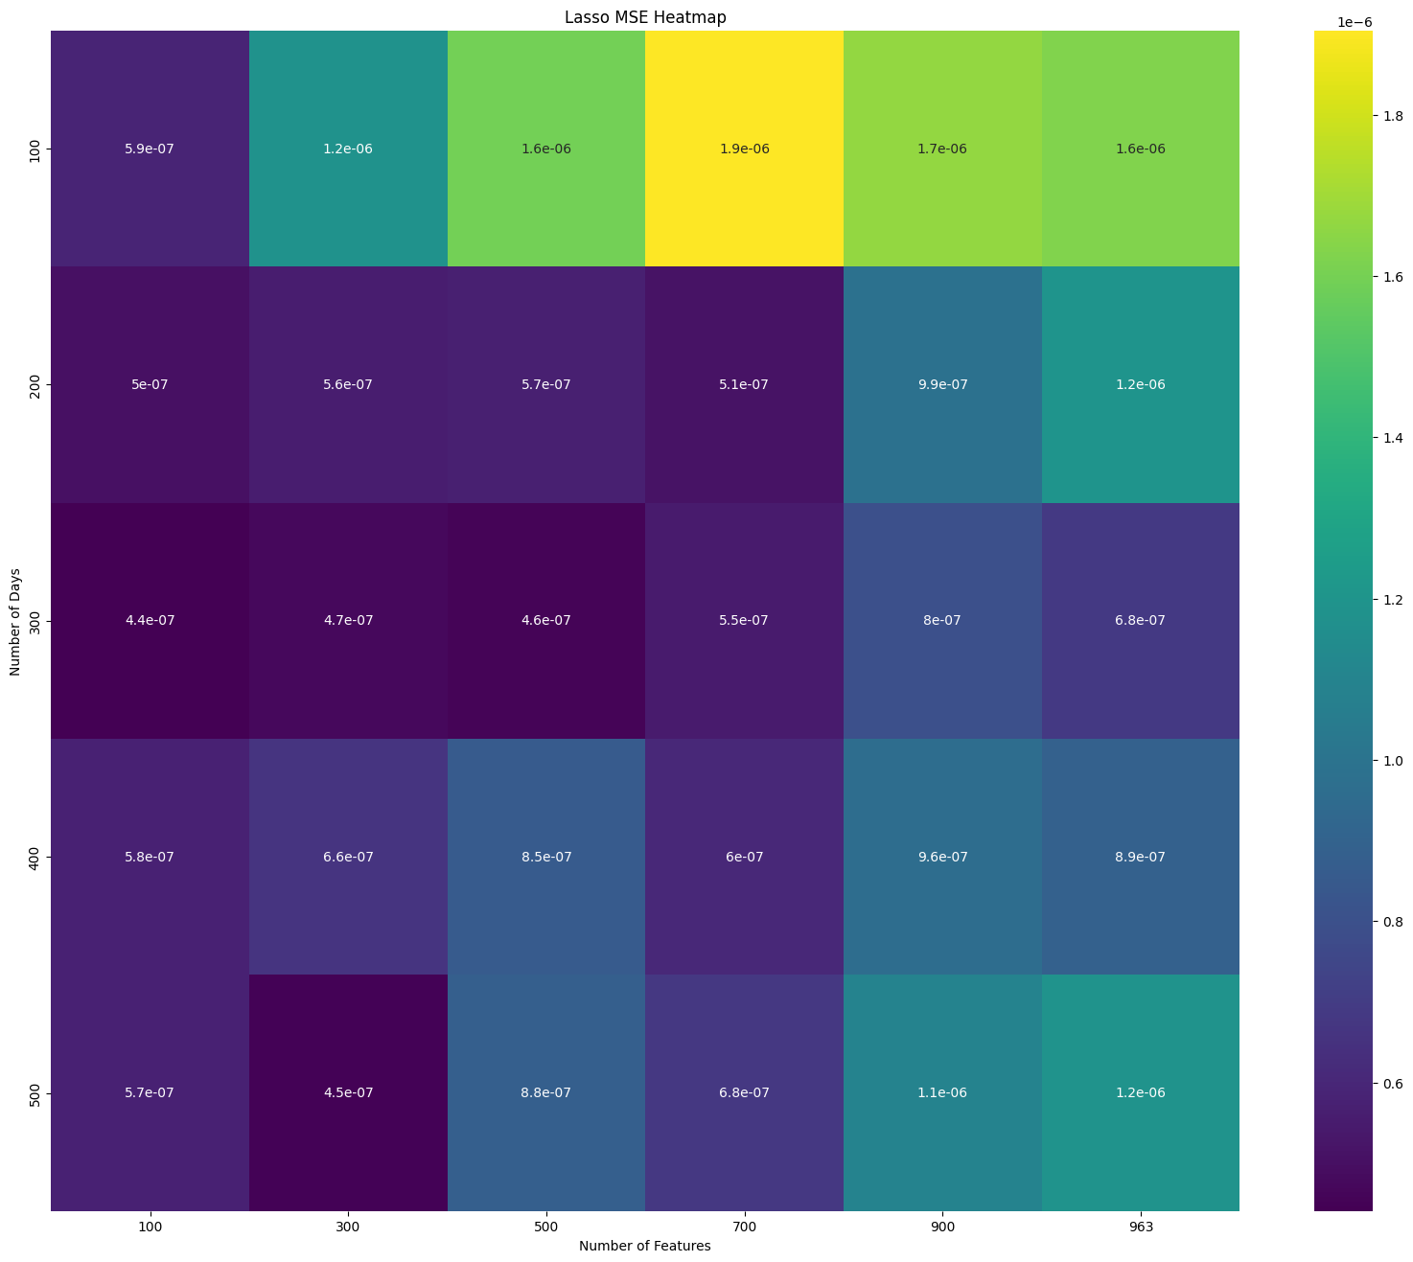
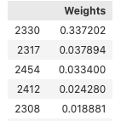
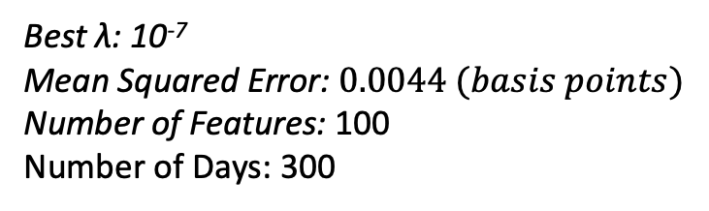
Numerical Results:
Best λ: 10⁻⁷
Mean Squared Error: $0.0044 (basis points)$
Number of Features: 100
Number of Days: 300

Slide 34

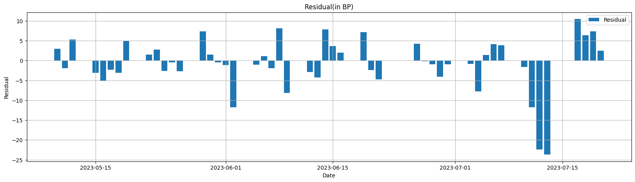
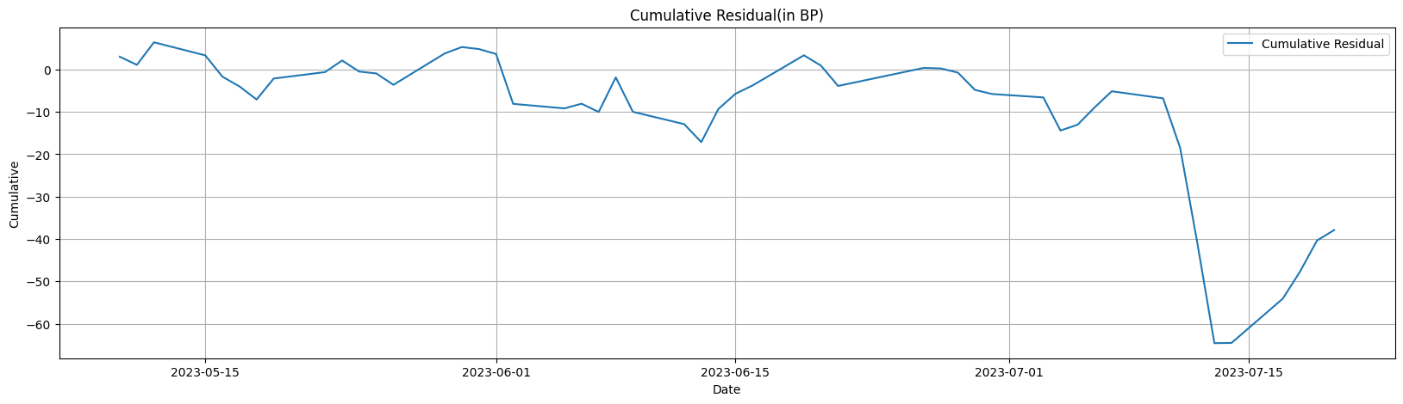
Numerical Results:
Residuals.
Cum. Residuals.

Slide 35
Method 3: Conjugate Gradient Research

Slide 36
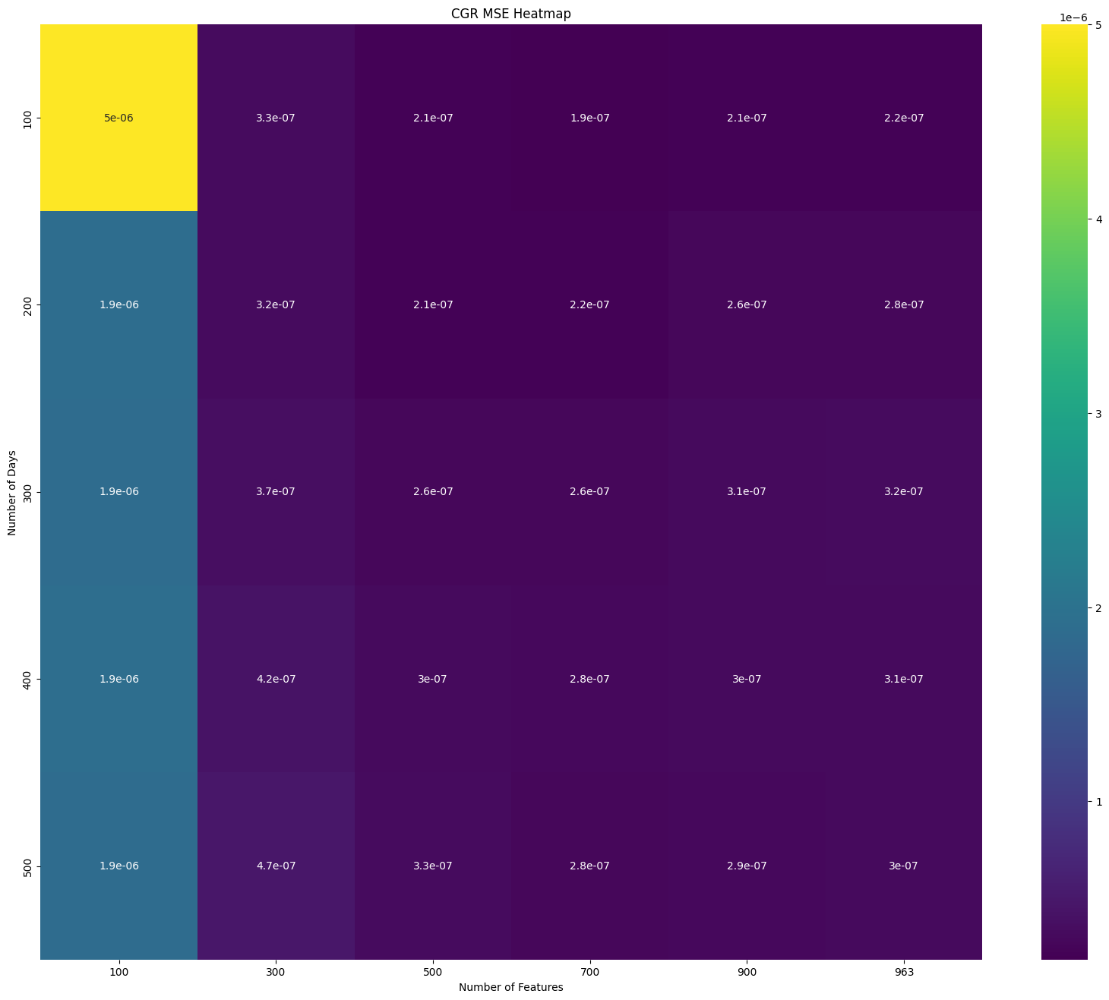
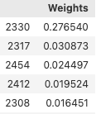
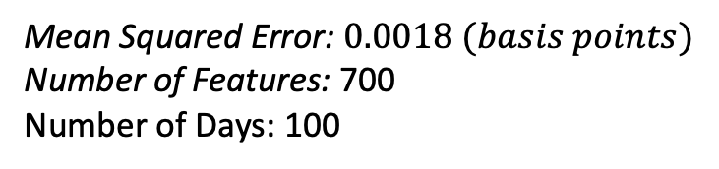
Numerical Results:
Mean Squared Error: $0.0018 (basis points)$
Number of Features: 700
Number of Days: 100

Slide 37
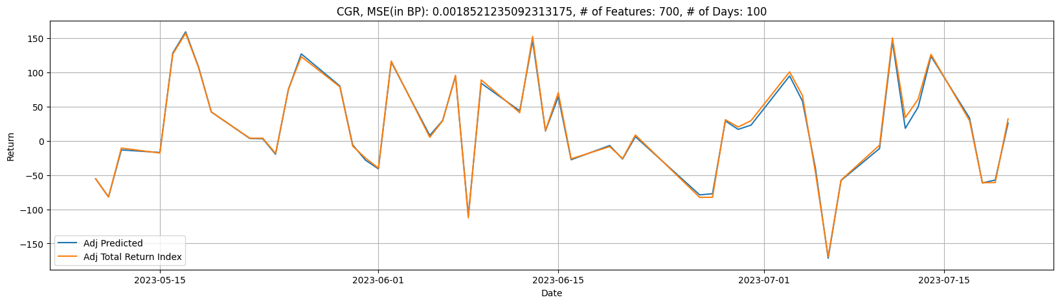
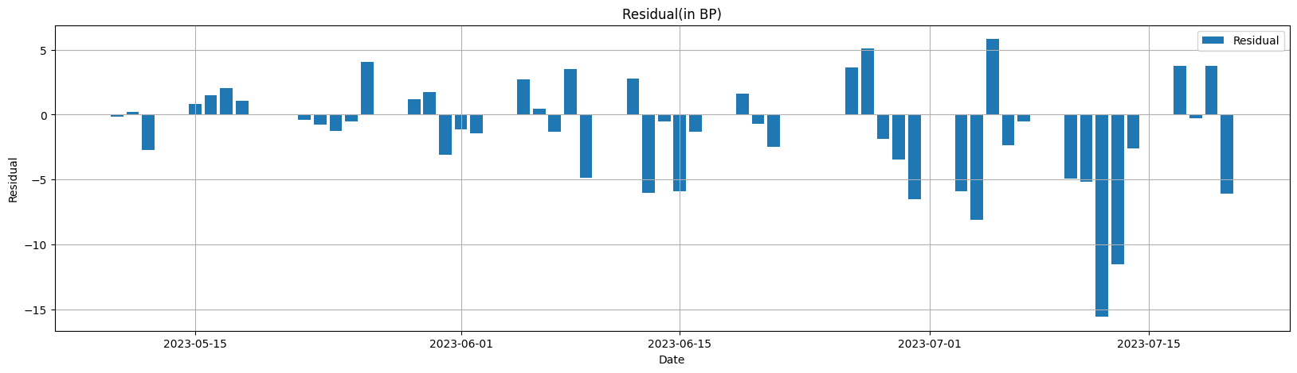
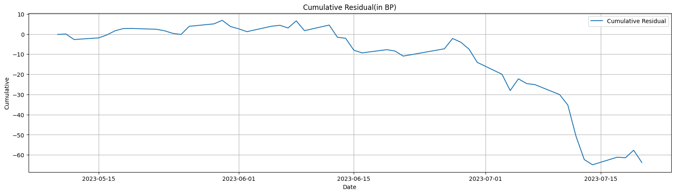
Numerical Results:
Residuals.
Cum. Residuals.

Slide 38
Inspection

Slide 39
Anomalies in Residuals:
Linear Regr.:
Lasso:
CGR:

Slide 40


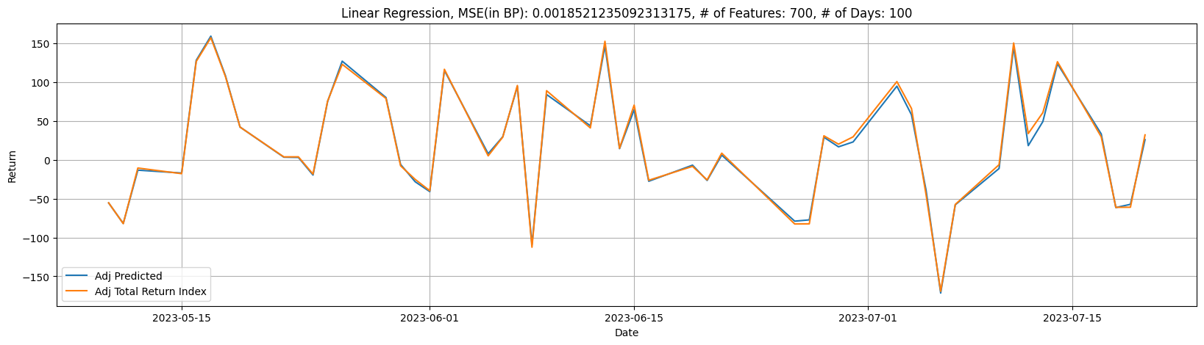
Anomalies in Residuals:
Linear Regr.:
Lasso:
CGR:

Slide 41
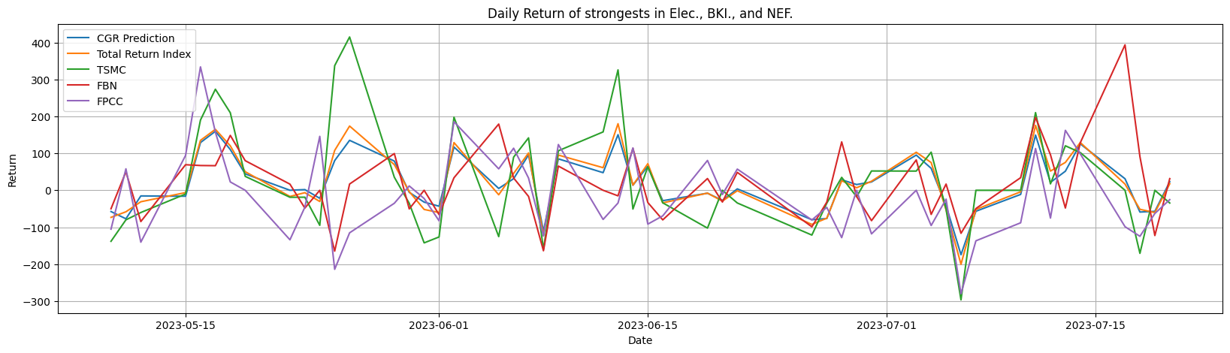
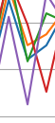
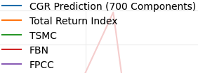
Look into TSMC, FBN and FPCC:

Slide 42
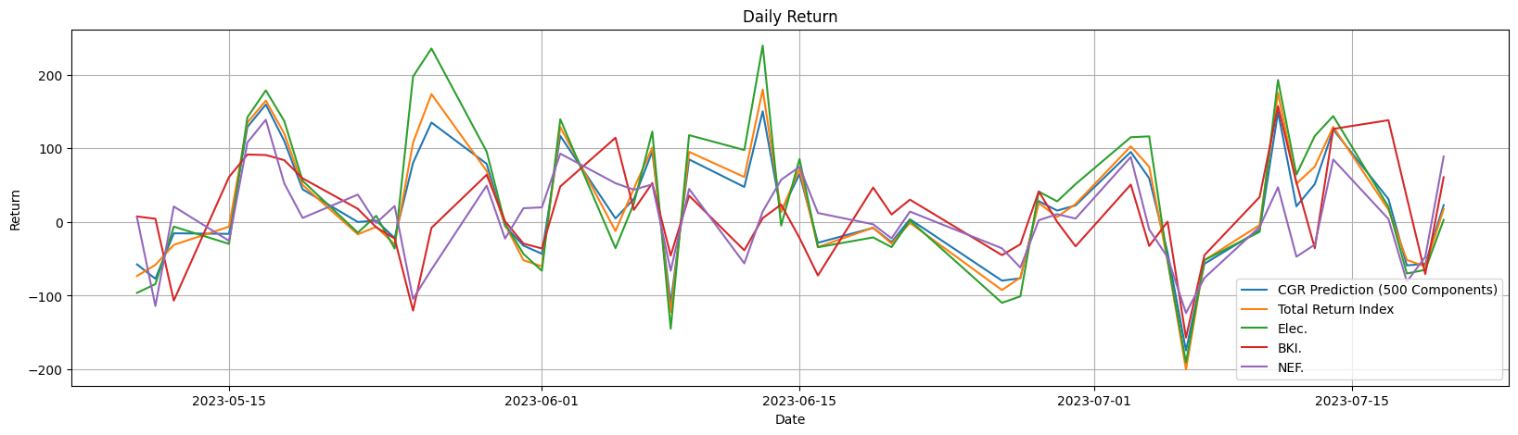

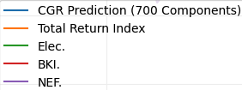
Look into Elec, BKI and NEF idx:

Slide 43
Big Mistake!!!
Our model: Heavily depends on weighted stocks (e.g. Elec.).
Reality: Stocks other than Elec. have majority in amount.
Choose different way of feature selection!!!!

Slide 44
Selection of Components

Slide 45
Selection Method 1: Replicate the Shape

Slide 46



Chosen by Weight VS Chosen by Amount:
$$≠$$

Slide 47

Chosen by Weight VS Chosen by Amount:

Slide 48


New replication approaches!
=

Slide 49



Numerical Results (Linear Regr.):
Mean Squared Error: $0.0049 (basis points)$
Number of Features: 100
Number of Days: 300

Slide 50



Numerical Results (Linear Regr.):
Residuals.
Cum. Residuals.

Slide 51



Numerical Results (Lasso):
Mean Squared Error: $0.004(basis points)$
Number of Features: 300
Number of Days: 300

Slide 52



Numerical Results (Lasso):
Residuals.
Cum. Residuals.

Slide 53



Numerical Results (CGR):
Mean Squared Error: $0.0014 (basis points)$
Number of Features: 700
Number of Days: 100

Slide 54



Numerical Results (CGR):
Residuals.
Cum. Residuals.

Slide 55
Comparison:
Original CGR:
Over 15 bps.
New approach CGR:
Below 12.5 bps.

Slide 56
Selection Method 2: Random Forest Feature Importance

Slide 57






Random Forest Feature Importance:
$$X$$
$$y$$
$$Tested$$
$$Feature$$
MSE_{original}
Fit
On
$$X$$
$$y$$
$$Messed$$
$$Tested$$
$$Feature$$
MSE_{messed}
Fit
On
Importance = MSE_{messed} - MSE_{original}

Slide 58

Importance of Components:

Slide 59



Numerical Results (Linear Regr.):
Mean Squared Error: $0.00056 (basis points)$
Number of Features: 100
Number of Days: 300

Slide 60



Numerical Results (Linear Regr.):
Residuals.
Cum. Residuals.

Slide 61



Numerical Results (Lasso Regr.):
Mean Squared Error: $0.00059 (basis points)$
Number of Features: 100
Number of Days: 300

Slide 62



Numerical Results (Lasso Regr.):
Residuals.
Cum. Residuals.

Slide 63



Numerical Results (CGR):
Mean Squared Error: $0.002(basis points)$
Number of Features: 900
Number of Days: 100

Slide 64



Numerical Results (CGR):
Residuals.
Cum. Residuals.

Slide 65
Selection Method 3: Feature Importance with Shape

Slide 66



Importance of Components of each Division:
Elec. Importance
BKI. Importance
NEF. Importance

Slide 67



Numerical Results (Linear Regr.):
Mean Squared Error: $0.0012(basis points)$
Number of Features: 100
Number of Days: 500

Slide 68



Numerical Results (Linear Regr.):
Residuals.
Cum. Residuals.

Slide 69



Numerical Results (Lasso Regr.):
Mean Squared Error: $0.0012 (basis points)$
Number of Features: 100
Number of Days: 500

Slide 70



Numerical Results (Lasso Regr.):
Residuals.
Cum. Residuals.

Slide 71



Numerical Results (CGR):
Mean Squared Error: $0.0014(basis points)$
Number of Features: 900
Number of Days: 100

Slide 72



Numerical Results (CGR):
Residuals.
Cum. Residuals.

Slide 73
Conclusion and Possible Amelioration

Slide 74

Possible Amelioration:
Some obstacles……
NaNs. (Need to find the better way to deal with it!!)
Anomaly in Weights.
Calculation Capacity. ( 2⁹⁶³-1 iterations)
Some stocks are dominating the market.
Possible Amelioration……
Divided by more sections. (not just Elec, BKI…)
Try other optimization technique (not just CGR).
Length of Testing Dates.
Include the way of choosing the components into account.
$$N_{components}×N_{days}×Model×Feature Selection$$

Slide 75
Conclusion (in basis points):
With best parameters……
MSE | Select by Weights | Select by Shape | Select by Importance | Importance and Shape
Benchmark | 0.0013 | 0.0014 | 0.0027 | 0.0014
Linear Regr. | 0.0045 | 0.0049 | 0.00056 | 0.0012
Lasso Regr. | 0.0044 | 0.004 | 0.00059 | 0.0012
CGR | 0.0018 | 0.0013 | 0.002 | 0.0014
Max |Residual| | Select by Weights | Select by Shape | Select by Importance | Importance and Shape
Benchmark | 12.4 | 12.4 | 16.3 | 11
Linear Regr. | 23.5 | 24 | 6.7 | 8.5
Lasso Regr. | 23.7 | 19.4 | 6.9 | 9.9
CGR | 15.6 | 12.4 | 15 | 12

Slide 76
Conclusion:
Have to find the way to deal with NaNs better!!
Results of regression is not reasonable due to our approaches of dealing with NaNs.
CGR based on initial weighting might be the best and the most reasonable way for now.
Choosing the features based on the Importance rather than weights has better performance.
To divide into sections can as well perform better than not to.

